Slide 1
Hurricane Laura Response
By

Slide 2
HURRICANE LAURA DISASTER RELIEF AND RECOVERY FUND While the damage to properties in Orange County was not as severe as expected, there are still a lot of people who do have damage and will need help recovering. To aid in the process, we have established a Hurricane Laura Disaster Relief Fund. As of 9/30/2020, we have received $88,461.25.

Slide 3
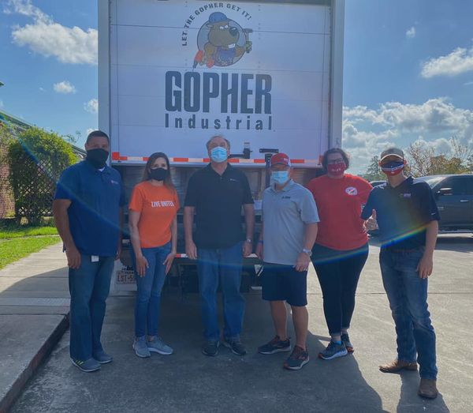
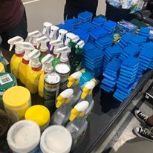
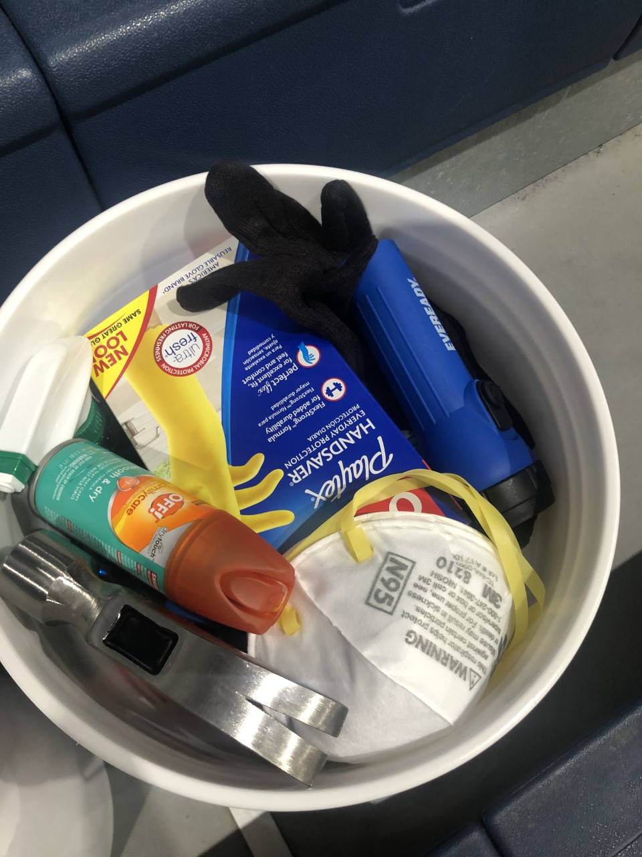
We worked to secure, sort and package disaster relief supplies. We have estimate in-kind donations at $55,708.32 as of 9/30/2020.

Slide 4
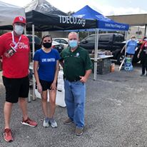
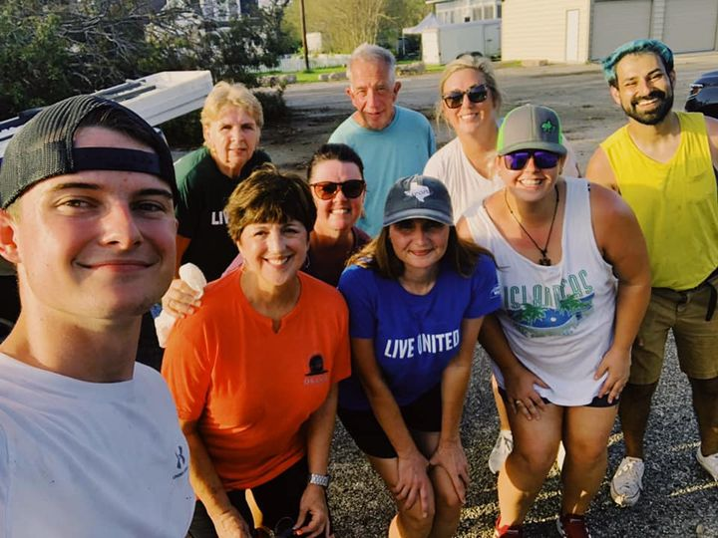
We coordinated and worked two lunch, one dinner, and a pet food distribution.

Slide 5
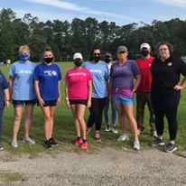
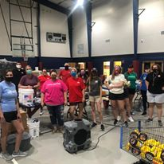
We coordinated over 150 volunteers who served over 650 hours.

Slide 6
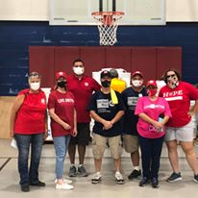
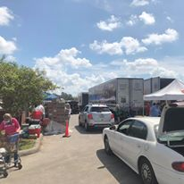
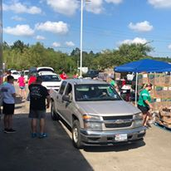
We partnered with The Salvation Army for a major supply distribution to serve over 700 families.

Slide 7
Collaboration. Network. Resources. It’s what we do.
Just two days after Laura hit…
At 6:45 a.m. we were contacted by The Salvation Army stating that there was an immediate need for ice. We knew a heat advisory was in effect. We got on the phone and did what we do. At 9:35 a.m., a truck with 8 pallets of ice was dropped off at The Salvation Army so that it could be distributed to those in need! You may not always see us, but rest assured that we are diligently working behind the scenes to bring supplies, resources, and funding to Orange County. And working with partners, such as The Salvation Army, we can do so much more!

